Slide 1
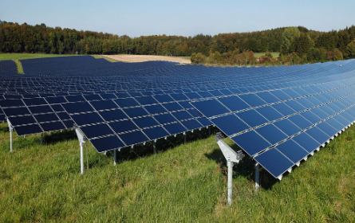
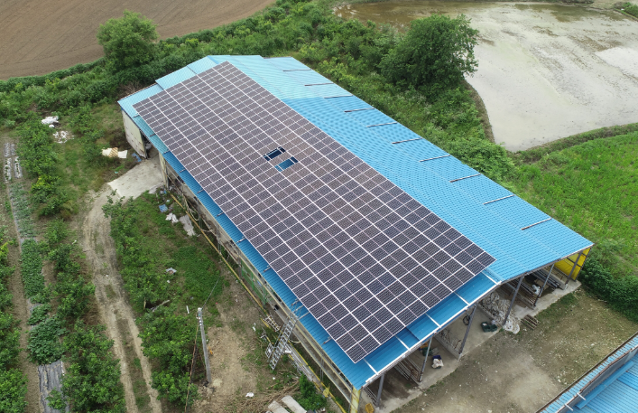
Company Information
 | 1. HYUNDAI SOLAR TECH
 | Park Su ryeon
 | www.hdstec.co.kr
Company Name
Representative Name
Homepage
Product Information
Product Information
Product Description
PV panel, Agrivoltaic, ESS , Automatically generate monthly income, enable unmanned management, and replace agricultural income with solar power generation
HS Code (6 digits)
Features
As a partner of the solar power generation business, Hyundai Solar Tech is committed to developing excellent environmental energy technology and becoming a leader in green growth and renewable energy
Additional Information
 | Main-Biz, Inno-BIZ, Global IP STAR ,T3
 | -
 | -Participation in Housing/Building Support Project of Korea Energy Agency , Energy Valley
Certifications
Export Areas
Local/Global Clients

